Slide 1
Writing Good Software Engineering Research Papers
A Paper by
Mary Shaw
In Proceedings of the 25th International Conference on Software Engineering (ICSE), IEEE Computer Society, 2003, pp. 726-736.

Slide 2
1
Questions

Slide 3
1. Questions ?
♦ What, precisely, was your contribution?
  What question did you answer?
  Why should the reader care?
  What larger question does this address?
♦ What is your new result?
  What new knowledge have you contributed that the reader can use elsewhere?
  What previous work (yours or someone else’s) do you build on? What do you provide a superior alternative to?
  How is your result different from and better than this prior work?
  What, precisely and in detail, is your new result?
♦ Why should the reader believe your result?
  What standard should be used to evaluate your claim?
  What concrete evidence shows that your result satisfies your claim?

Slide 4
2
What, precisely, was your contribution?

Slide 5
2. What, precisely, was your contribution?
What kinds of questions do software engineers investigate?
Which of these are most common?
What do program committees look for?

Slide 6
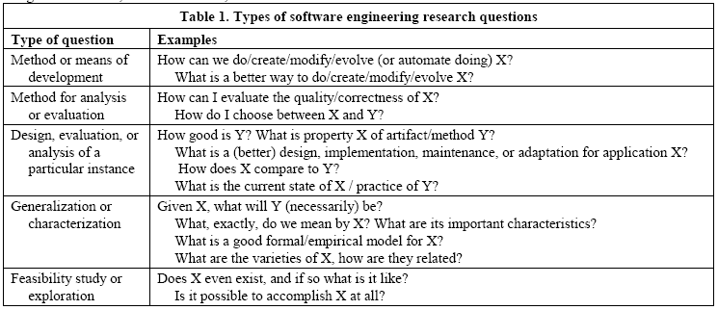
What kinds of questions do software engineers investigate?

Slide 7
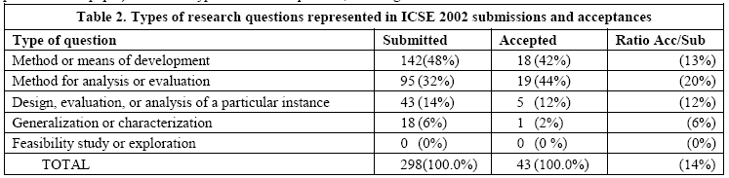
Which of these are most common?

Slide 8
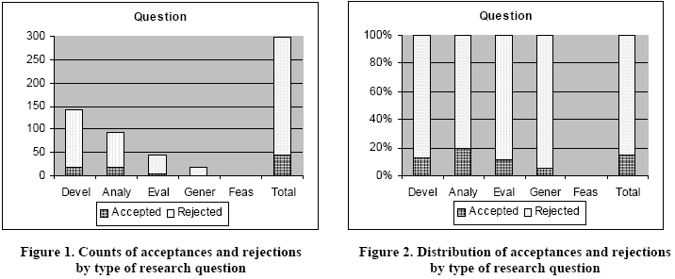

Slide 9
What do program committees look for?
A clear statement of the specificproblem you solved
The question about software development you answered, and
An explanation of how the answer will help solve an important software engineering problem.

Slide 10
3
What is your new result?

Slide 11
3. What is your new result?
What kinds of results do software engineers produce?
Which of these are most common?
What do program committees look for?

Slide 12
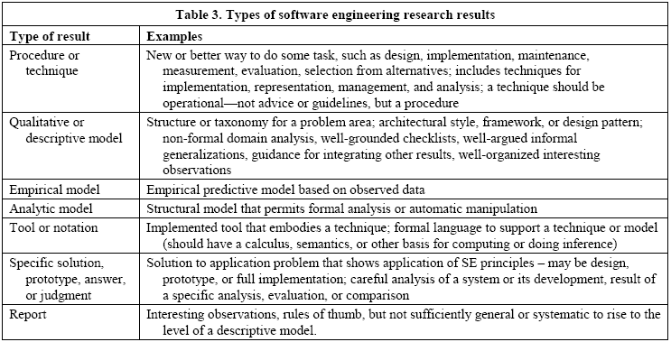
What kinds of results do software engineers produce?

Slide 13
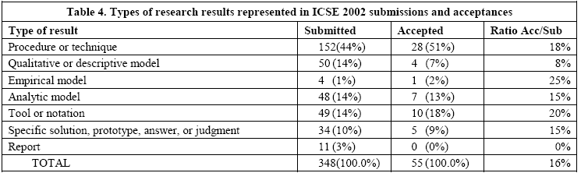
Which of these are most common?

Slide 14
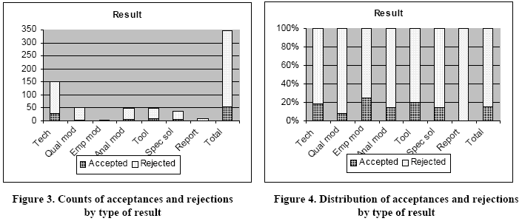

Slide 15
What do program committees look for?
Interesting, novel, exciting results that
Significantly enhance our ability
  to develop and maintain software,
  to know the quality of the software we develop,
  to recognize general principles about software, or
  to analyze properties of software.

Slide 16
What, precisely, do you claim to contribute?
What’s new here?
What has been done before? How is your work different or better?
What, precisely, is the result?

Slide 17
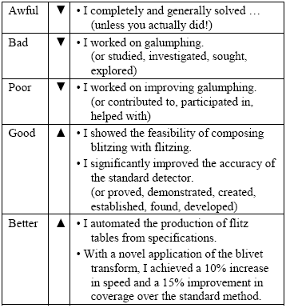
Claims

Slide 18
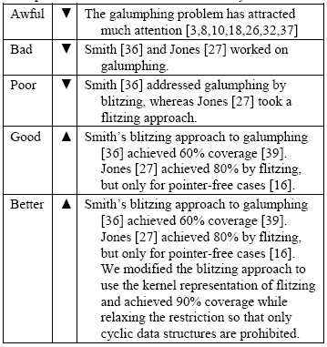
Relation to other work

Slide 19
What, precisely, is the result?
If you introduce a new model,
  be clear about its power.
If you introduce a new metric,
  define it precisely.
If you introduce a new architectural style, design pattern, or similar design element,
  treat it as if it were a new generalization or model.
If your contribution is principally the synthesis or integration of other results or components,
  be clear about why the synthesis is itself a contribution.
If your paper is chiefly a report on experience applying research results to a practical problem,
  say what the reader can learn from the experience.
If a tool plays a featured role in your paper,
  what is the role of the tool?
If a system implementation plays a featured role in your paper,
  what is the role of the implementation?

Slide 20
4
Why should the reader believe your result?

Slide 21
4. Why should the reader believe your result?
What kinds of validation do software engineers do?
Which of these are most common?
What do program committees look for?

Slide 22
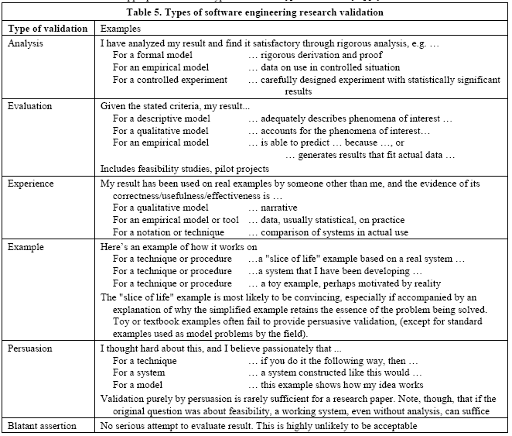
Validation

Slide 23
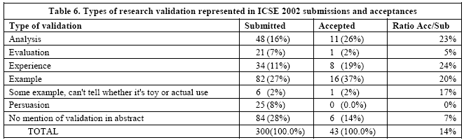
Which of these are most common?

Slide 24
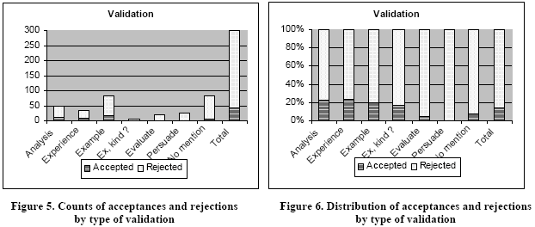

Slide 25
What do program committees look for?
Why should the reader believe your result?
  If you claim to improve on prior art,
    compare your result objectively to the prior art.
  If you used an analysis technique,
    follow the rules of that analysis technique.
  If the technique is not a common one,
    explain the technique and standards of proof, and be clear about your adherence to the technique.
  If you offer practical experience as evidence for your result,
    establish the effect your research has.
  If you performed a controlled experiment,
    explain the experimental design.
  If you performed an empirical study,
    explain what you measured, how you analyzed it, and what you concluded.
  If you use a small example for explaining the result,
    provide additional evidence of its practical use and scalability.

Slide 26
5
How do you combine the elements into a research strategy?

Slide 27
5. How do you combine the elements into a research strategy?
to find a better way to perform some software development or maintenance task, realize this in a concrete procedure supported by a tool, and evaluate the effectiveness of this procedure and tool by determining how its use affects some measure (e.g., error rates) of quality.
to find a better way to evaluate a formalizable property of a software system, develop a formal model that supports inference, and to show that the new model allows formal analysis or proof of the properties of interest.

Slide 28
Validating the correctness of a formal model through field study is as inappropriate as attempting formal verification of a method based on good organization of rules of thumb.
Selecting a type of result that will answer a given question usually does not seem to present much difficulty, at least for researchers who think carefully about the choice.
Blindly adopting the research paradigm someone used last year for a completely different problem is a different case, of course, and it can lead to serious misfits.
Choosing a good form of validation is much harder, and this is often a source of difficulty in completing a successful paper.

Slide 29

Validation ?
An Advice !
Look carefully at the short statement of the result
  the principal claim of the thesis.
This often has two or three clauses
  (e.g., I found an efficient and complete method …");
  if so, each presents a separate validation problem.
  Ask of each clause whether it is
    a global statement ("always", "fully"),
    a qualified statement ("a 25% improvement", "for noncyclic structures…"), or
    an existential statement {"we found an instance of").
  Global statements often require analytic validation,
  Qualified statements can often be validated by evaluation or careful examination of experience, and
  Existential statements can sometimes be validated by a single positive example.
Restate the thesis claims to reflect more precisely what the theses actually achieve.

Slide 30
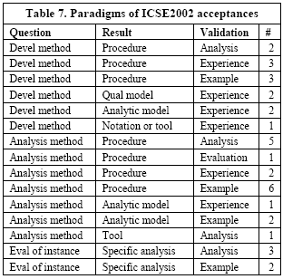

Slide 31
6
Does the abstract matter?

Slide 32
6. Does the abstract matter?
Two or three sentences about the current state of the art, identifying a particular problem
One or two sentences about what this paper contributes to improving the situation
One or two sentences about the specific result of the paper and the main idea behind it
A sentence about how the result is demonstrated or defended

Slide 33
What about this report itself?
There is no attempt to show that anyone else can apply the model. That is, there is no demonstration of inter-rater reliability, or for that matter even repeatability by the same rater.
The model is not justified by any principled analysis, though fragments, such as the types of models that can serve as results, are principled. In defense of the model, Bowker and Starr [2] show that useful classifications blend principle and pragmatic descriptive power.
Only one conference and one program committee is reflected here.
The use of abstracts as proxies for full papers is suspect.
There is little discussion of related work other than the essays about writing papers for other conferences. Although discussion of related work does appear in two complementary papers [19, 20], this report does not stand alone.

Slide 34
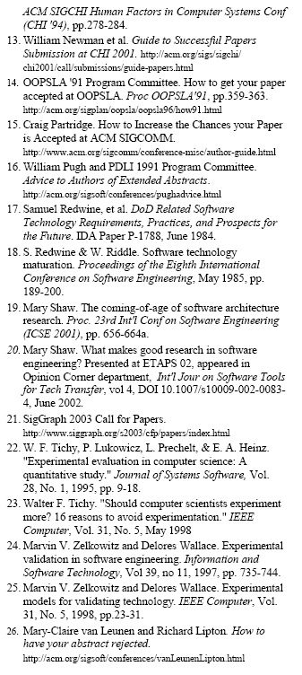
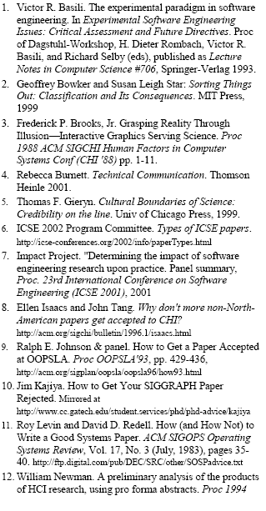
References

